Slide 1
Art Store Marketplace
Anna, Yosef, Shobha

Slide 2
Background
Online storefront to sell prints of famous artwork
Front End: HTML, CSS, JavaScript, S3
Back End: EC2
Database: MySQL

Slide 3
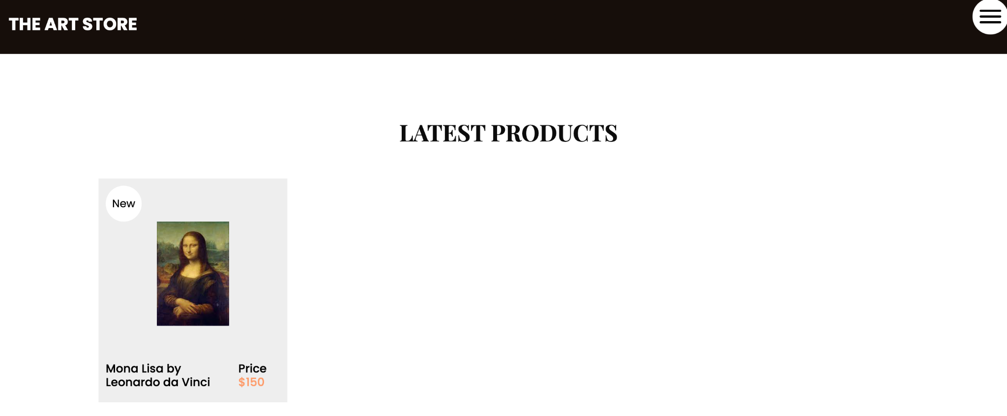
Features
Home page
View products
List and individual pages for each product
Checkout
Handled by Stripe

Slide 4
Privacy Policy
Generated online using Termly
Difficult to read
Basic summary
We are allowed to use a customer’s information for “internal research” purposes
We don’t sell data to third parties
We collect personal information (name, address, phone number) and transactional data (purchase history, transaction details, etc.)
We don’t collect browsing data, location data, and photos or videos
Located on the bottom of all website pages, except the checkout screen
Since we don’t collect very sensitive data, and credit card information is handled through Stripe, our privacy policy doesn’t need to be plastered everywhere, but it’s not hard to find if you’re looking for it

Slide 5
Stripe
We chose to use Stripe because we didn’t want to be responsible for storing and processing credit card data under PCI regulations
Stripe also allows for streamlined purchase options
Credit Card, ApplePay, CashApp Pay, Affirm, Klarna, Afterpay, Link
Stripe stores transaction and customer data for us, no need to store it in our own database
Reduces the amount of security we need to deal with
We initially planned on having user accounts to store this data, but we can collect information on our customers without incurring extra security risks ourselves
We have to rely on Stripe to keep our customers’ data private

Slide 6
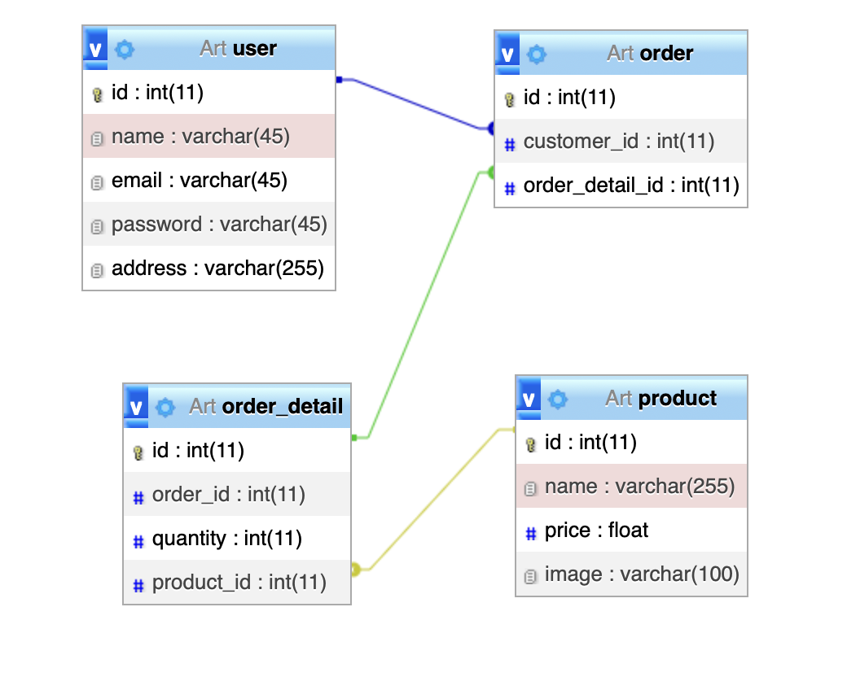
RDS
After creating a prototype with HTML/JavaScript and hardcoded products, we made a version that incorporated PHP and SQL
We had errors running the database with RDS, so we decided to focus on using the HTML version without a database for our demo since we know it works

Slide 7
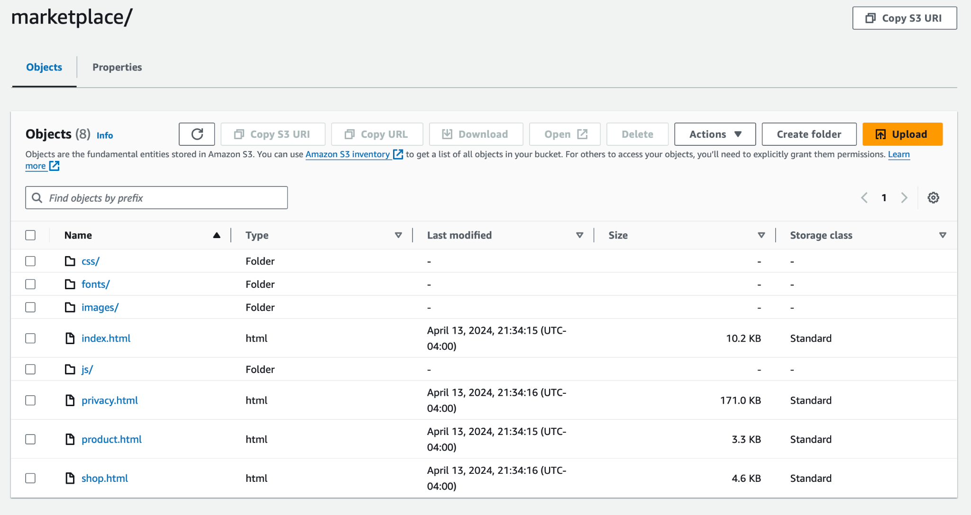
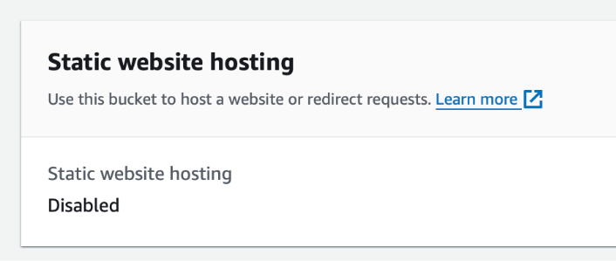
S3
The website files are hosted in an s3
Originally, we enabled “static website hosting,” allowing the s3 to be accessed as a site

Slide 8
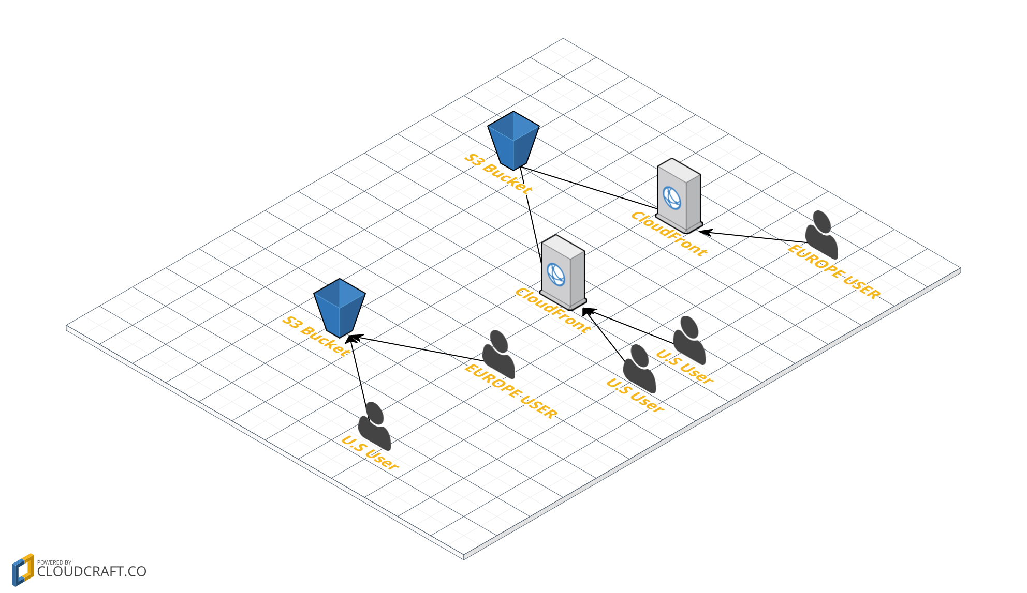
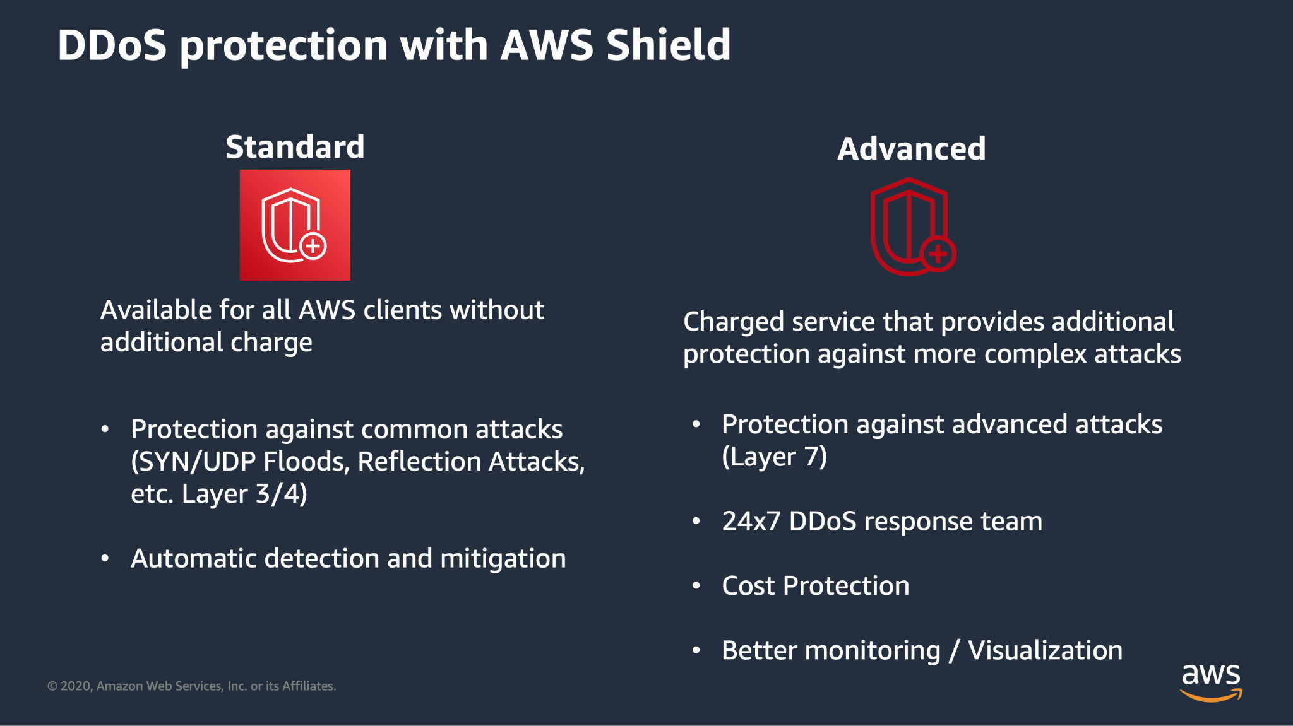
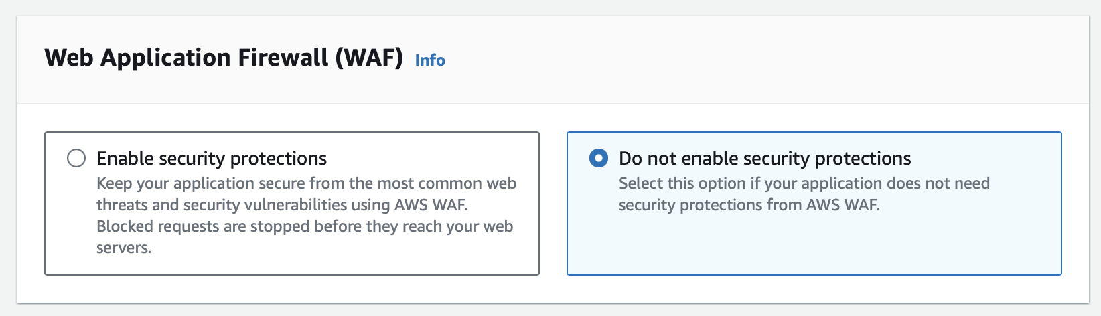
CloudFront
CloudFront does not host the files–they are still in the S3
CloudFront is a Content Delivery Network
Middleman that allows users to access the contents of the S3 without directly connecting to it
All CloudFront users have AWS Shield Standard–protection
Easy way to make our website more secure that we did not do because of budget

Slide 9
Introduction to CloudWatch and Log Monitoring
Purpose of CloudWatch: Monitoring and management for AWS resources.
Importance of Logs: Provide insights into application behavior and system health.
Objective: Set up metric alarms based on log data to manage system and application health.
Benefits of Updating the SNS (Simple Notification Service)
Enhanced Security
Improved Clarity
Tailored Notifications
Cost Management
Compliance
Operational Efficiency
Reliability
Flexibility
Notes:
Shobha

Slide 10
Process Steps for Updating Default CloudWatch Alarms
Access the SNS Dashboard
Locate the Topic
Edit Topic Settings
Manage Subscriptions
Update Access Policies
Save Changes
Modify CloudWatch Alarm Settings
Test the Configuration
Notes:
Shobha

Slide 11
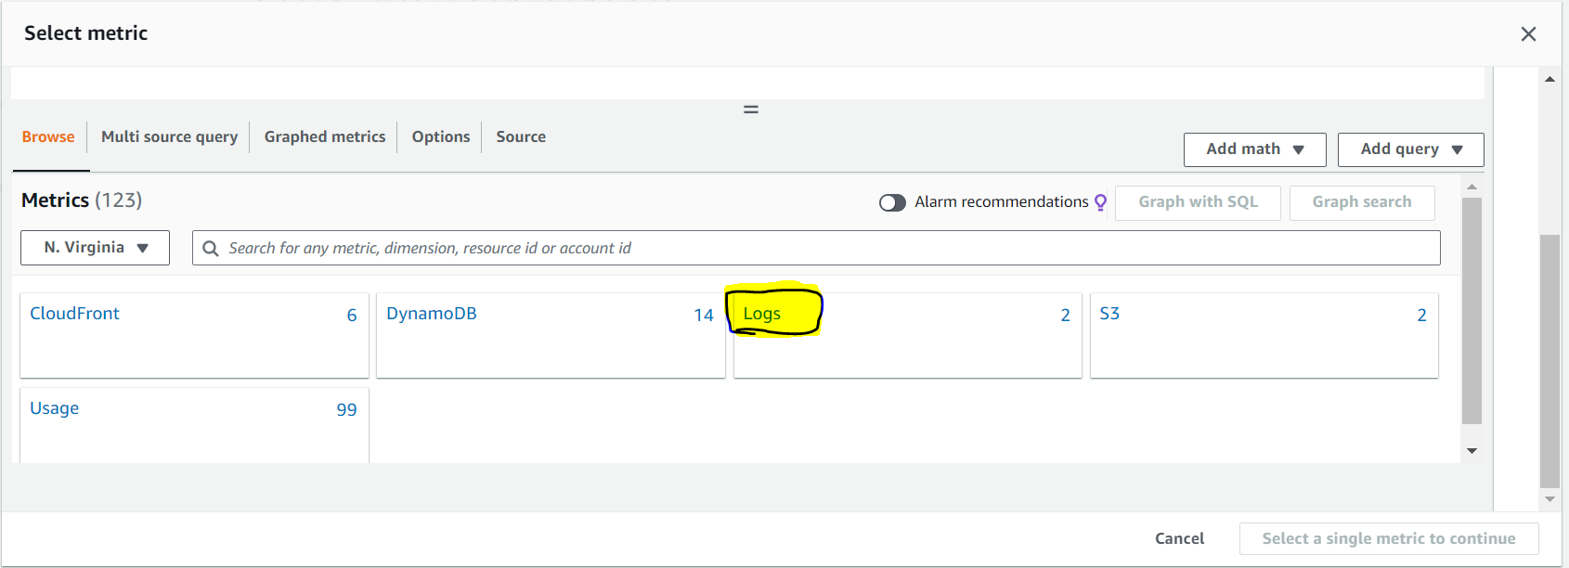
Custom Metrics from Logs
Access Log Groups: Navigate to CloudWatch -> Logs -> Log groups.
Analyze Logs: Use Log Insights for queries. Example query: filter @message like /Error/ | stats count() as errorCount by bin(5m).
Create Metric Filters: Define filter pattern and configure metric details (Namespace, Metric Name).
Notes:
Shobha

Slide 12
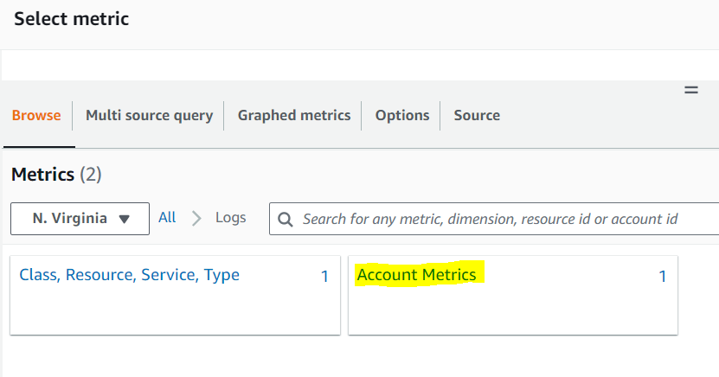
Setting Up the Alarm
Configure the Alarm: Navigate to Alarms -> Create new -> Select custom metric.
Define Conditions: Example - ErrorCount > 100 in 5 minutes.
Configure Actions: Set up notifications via Amazon SNS, e.g., sending an alert email.
Notes:
Shobha

Slide 13
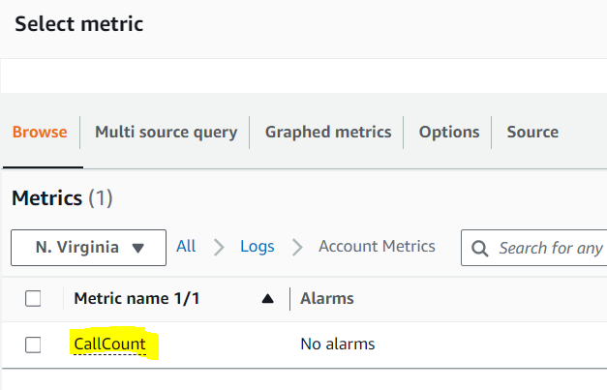
Select Metric
Notes:
Shobha

Slide 14
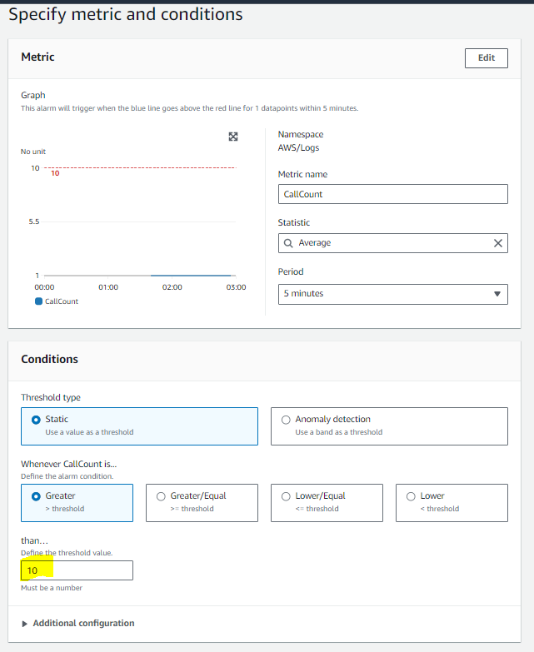
Specify metric and conditions
Notes:
Shobha

Slide 15
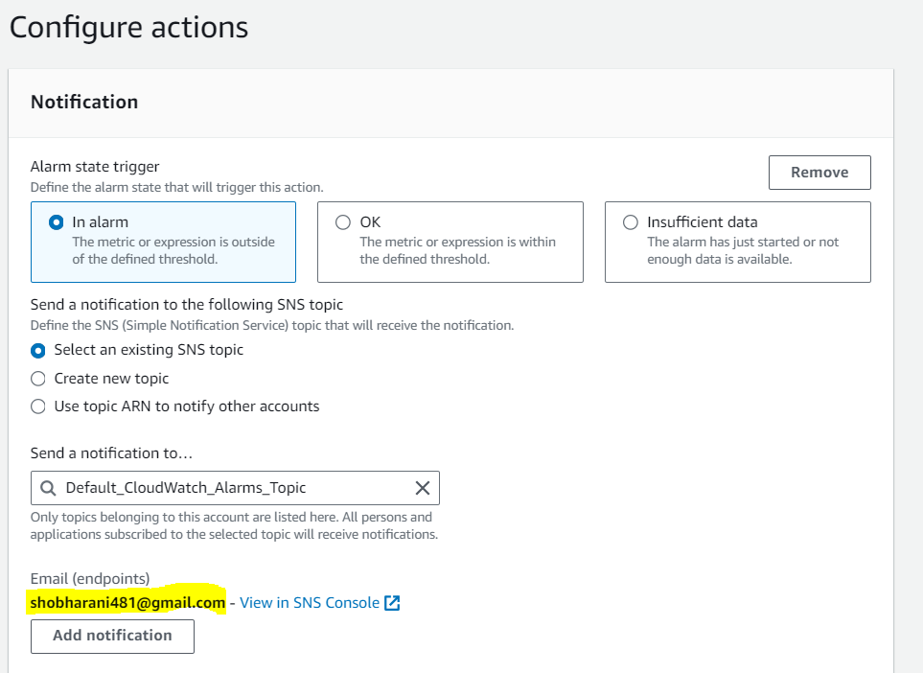
Configure actions
Notes:
Shobha

Slide 16
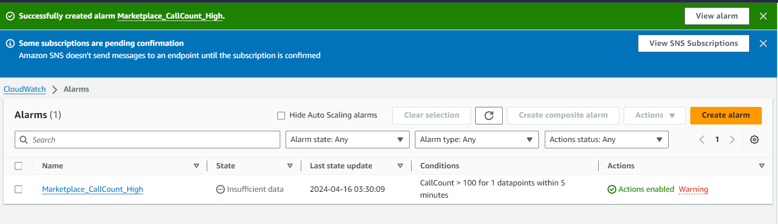
Alarms
Notes:
Shobha

Slide 17
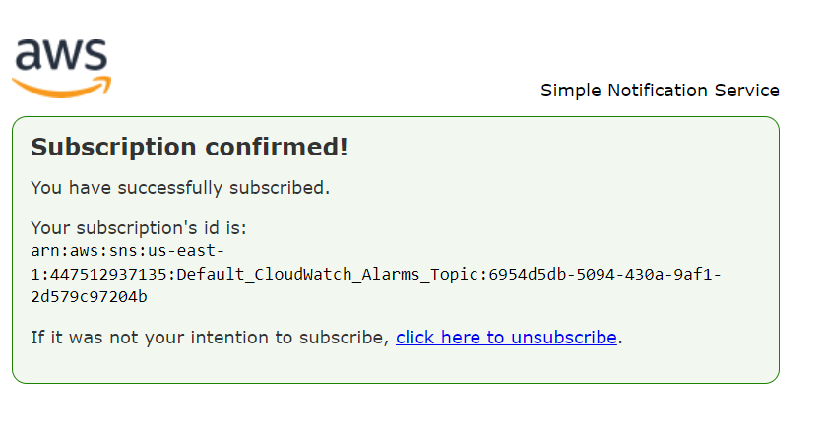
Subscription confirmed
Notes:
Shobha

Slide 18
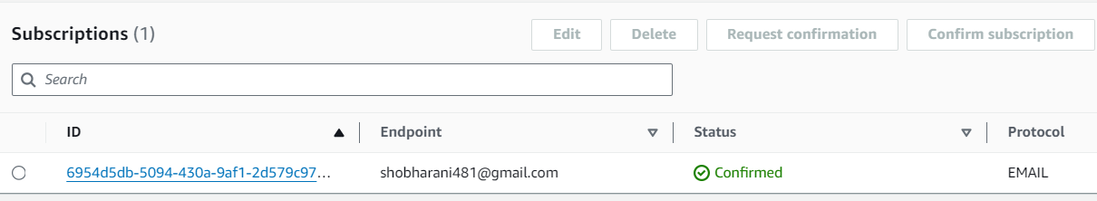
Finalize Setup
Notes:
Shobha

Slide 19
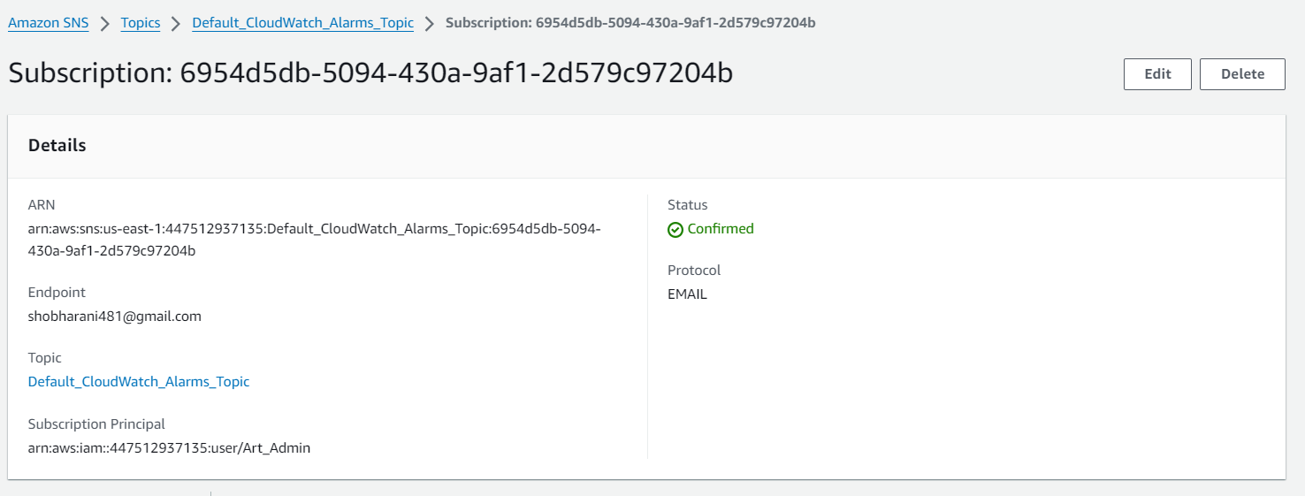
Subscription confirmed in AWS service
Notes:
Shobha

Slide 20
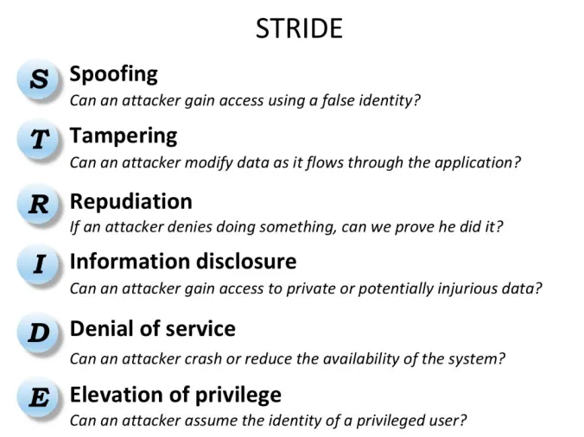
STRIDE
Spoofing:
We are not using accounts
Payment is done through Stripe, a secure third party
Tampering:
This version does not use SQL, so no SQL injection
Vulnerability scan says we have open ports
Repudiation:
CloudWatch and CloudTrail should help with this
Information Disclosure:
We do not collect private data beyond name and phone number, which goes through Stripe
Denial of Service:
DDOS protection from CloudFront
Elevation of Privilege
We have an IAM account with admin privileges used for group collaboration; this could be hacked

Slide 21
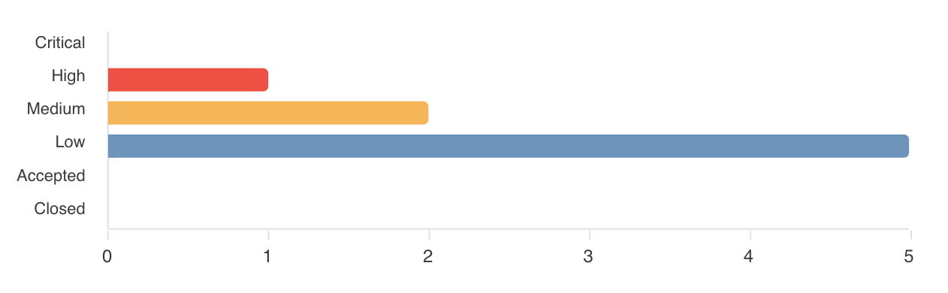
Vulnerability Scan (HostedScan)
OpenVAS
High Risk
SSL/TLS: Report Vulnerable Cipher Suites for HTTPS (vulnerable to SWEET32 attack)
Medium Risk
SSL/TLS: Deprecated TLSv1.0 and TLSv1.1 Protocol Detection
Low Risk: TCP Timestamps Information Disclosure
OWASP ZAP
Medium Risk
Content Security Policy (CSP) header not set
Low Risk
Server Leaks Version Information via "Server" HTTP Response Header Field
Strict-Transport-Security Header Not Set
Nmap: Low risk (open ports 80 and 443)

Slide 22
Other Features (Budget Permitting)
Amazon Inspector
Vulnerability management service
Continually scans workloads for software vulnerabilities and network exposure
Amazon Guard Duty
Threat detection service
Continually monitors for malicious activity and unauthorized behavior
Protects accounts, workloads, and S3 data
AWS Trusted Advisor
Lets you assess your environment against security standards and best practices
Helps optimize cost and improve application performance

Slide 23
Demo

